Slide 1
Jackson Valley Irrigation District Board Meeting Treated Water Rate Study Findings
Abigail Seaman, Utility Finance Consultant III
May 14, 2025

Slide 2
WELCOME!
©2025. Funding for this project has been provided in full or in part under the Safe and Affordable Funding for Equity and Resiliency (SAFER) Drinking Water Program through an agreement with the State Water Resources Control Board. The contents of this document do not necessarily reflect the views and policies of the foregoing, nor does mention of trade names or commercial products constitute endorsement or recommendation for use.
Notes:
2

Slide 3
Decision Points at the Last Board Meeting
What can we assume for future labor costs, contract or no contract?
LARA Water Conservation?
25 Additional customers on the LARA/Krethline Distribution System

Slide 4
Feedback from the Advisory Committee
JVID will assume contract labor costs to be conservative
Assume LARA will install an irrigation system and use less water
Reduce rate increase from 8% to 6.5% to keep bill under $100 in 5 years

Slide 5
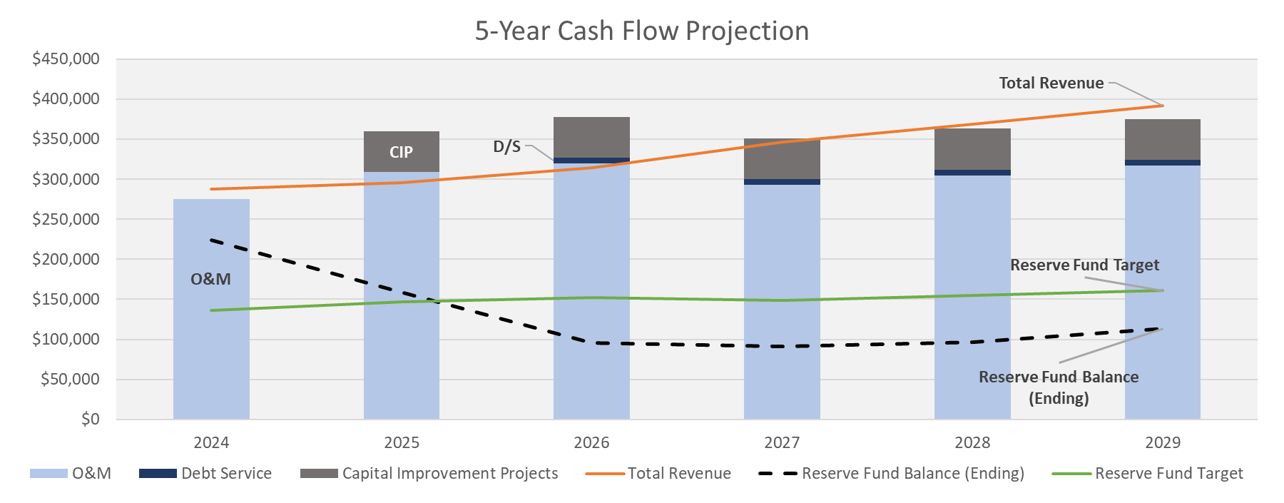
Proposed Rate Adjustment – 6.5% Annual Increases

Slide 6
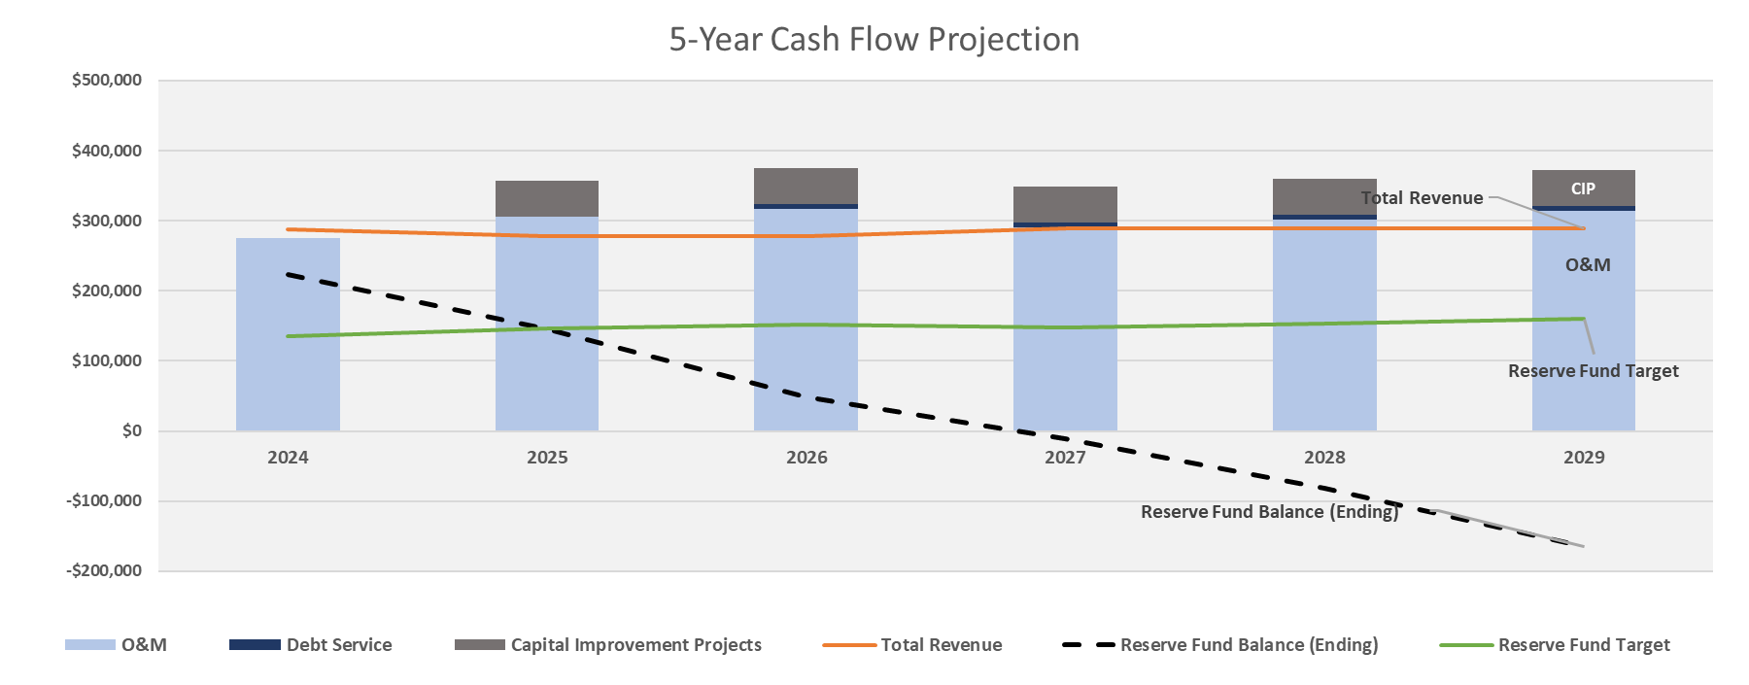
Status Quo – No Rate Increases

Slide 7
Treated Water Fixed Rate – AWWA Meter Capacity Ratios
Meter Size | Current Rate | Current Ratio | Maximum Capacity (gpm) | Ratio | Proposed Rate
3/4" | $57.68 | 1.00 | 30 | 1.00 | $61.92
1" | $63.86 | 1.11 | 50 | 1.67 | $103.20
1.5" | $69.01 | 1.20 | 100 | 3.33 | $206.40
Notes:
Landfill is 1”
No one in the 1.5” category

Slide 8
Rate Affordability
$$\frac{total annual water or sewer bill}{median household income}$$
0-1.5% | 1.5-2.5% | >2.5%
No Affordability Risk | Medium Risk | High Risk
Notes:
Is it ok to recommend a rate decrease?
Work in small groups to vote

Slide 9
Rate Summary – Proposed 8% Annual Increase
 | Current 2024 | 2025 | 2026 | 2027 | 2028 | 2029
 |  | Restructure | 6.5% | 6.5% | 6.5% | 6.5%
Residential | $57.68 | $61.92 | $65.94 | $70.23 | $74.80 | $79.66
1" | $69.01 | $103.20 | $109.91 | $117.05 | $124.66 | $132.76
1.5" | $74.16 | $206.40 | $219.81 | $234.10 | $249.32 | $265.53
Volumetric Rates | $2.88 | $3.06 | $3.26 | $3.47 | $3.69 | $3.93
Typical Single Family Usage (5 kgals) | $72.10 | $77.21 | $82.23 | $87.57 | $93.27 | $99.33
Affordability | 1.1% | 1.2% | 1.3% | 1.3% | 1.4% | 1.5%
Contract Rates ($/gal) |  | Restructure | 6.5% | 6.5% | 6.5% | 6.5%
LARA | $0.00103 | $0.01207 | $0.01286 | $0.01369 | $0.01458 | $0.01553
Oaks MHP | $0.01396 | $0.01160 | $0.01235 | $0.01316 | $0.01401 | $0.01492
IBMI | New Cust. | $0.13997 | $0.14906 | $0.15875 | $0.16907 | $0.18006
0-1.5%
No Affordability Risk

Slide 10
California Proposition 218
Any time rates are increased, JVID must mail a notice to all ratepayers
Hold a public hearing 45 days after the notice is mailed
Customers have an opportunity to submit a written protest
If 50% or more customers submit a protest, rates cannot be passed

Slide 11
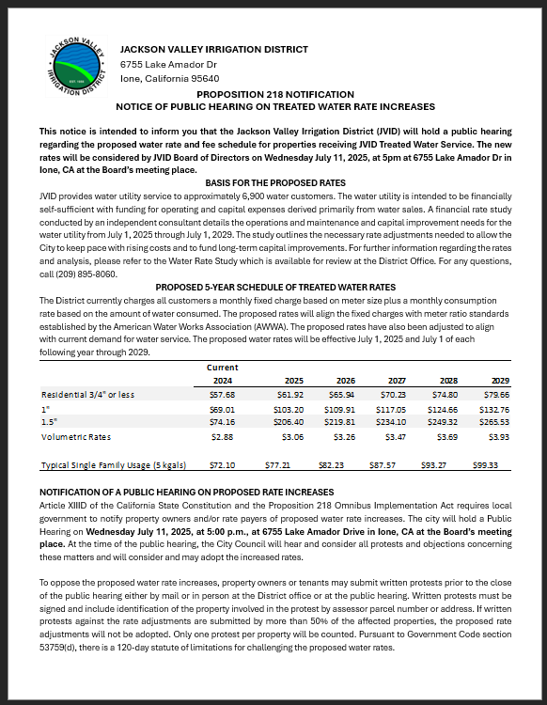
Proposition 218 Notice
Will be mailed to all treated water residential customers
Contract customer rates will be established separately
Other fees can be increased at the time of the public hearing

Slide 12
Next Steps
Authorize mailing the Prop 218 notice
The rates noticed are the maximum rates that the Board can adopt in each fiscal year
RCAC to produce a written report to be available to the public before the Hearing

Slide 13
Schedule
Public Hearing at the July 9 Meeting
Rates effective starting August 1, 2025 and each July 1 thereafter

Slide 14
Treated Water Rate Study Background
The last rate study conducted by RCAC informed the formation of the treated water system in 2019
RCAC is contracted to perform another rate study at no cost to the District to look at current usage levels and conduct an updated cost of service analysis
Assumed 3% Annual Increases
Currently on Year 6 of 5-Year Financial Plan
Ad Hoc Committee Review – February 19, 2025

Slide 15
Rate Study Process
Gather Information
Asset Listing
Financial Plan
How much money is needed to cover all expenses?
Cost of Service Analysis
How can we divide costs fairly between TW customers, LARA, Oaks, and IBMI?
Operating Budget
Current Fund Balance
Customer Data

Slide 16
Rate Study Process
Gather Information
Asset Listing
Financial Plan
How much money is needed to cover all expenses?
Cost of Service Analysis
How can we divide costs fairly between TW customers, LARA, Oaks, and IBMI?
Operating Budget
Current Fund Balance
Customer Data

Slide 17
Rate Study Process
Gather Information
Asset Listing
Financial Plan
How much money is needed to cover all expenses?
Cost of Service Analysis
How can we divide costs fairly between TW customers, LARA, Oaks, and IBMI?
Operating Budget
Current Fund Balance
Customer Data

Slide 18
Operating Budget
5.3% Increase
Average change in CPI 4% per year
Projected
2025-2029

Slide 19
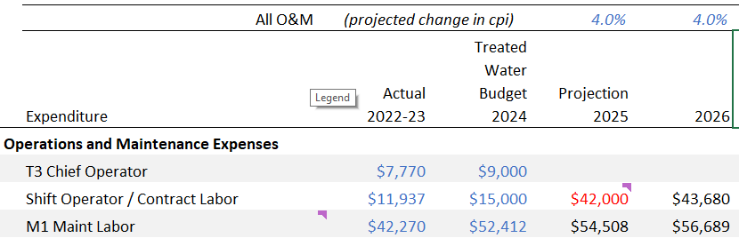
Contract Operator Assumptions

Slide 20
Customer Usage (gallons)
Based on 12 homes at 200 gpd
(average JVID water use)

Slide 21
LARA Usage

Slide 22
Oaks MHP Usage (gallons)
Oaks MHP has been repairing leaks to reduce water use

Slide 23
Capital Improvement Investment Plan
Most assets put in place in 2019 at the formation of the TW system
Useful life of assets ranges from 5-10 years for chemical feed pumps to 100-200 years for HDPE Pipelines
LARA Assets
$350,750
JVID System Assets
$6,091,650

Slide 24
Capital Improvement Investment Plan
The Capital Improvement Plan divides Replacement Value by Useful Life to determine annual contribution
Recommended increase in annual capital reserve funding from $43k to $51k
LARA Assets
$350,750
JVID System Assets
$6,091,650

Slide 25
Current TW Debt
Pay off County Bridge Loan (interest only payments) in 5 years - $7,000 per year

Slide 26
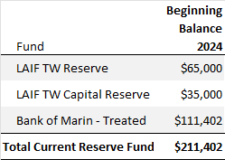
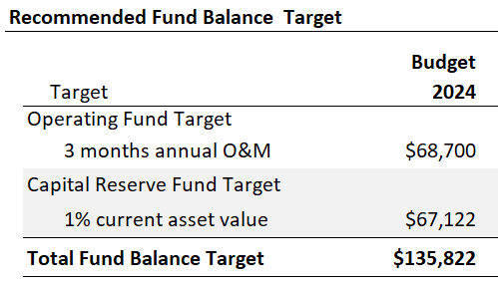
Reserve Fund Target

Slide 27
Cost Allocation Methodology
How do we allocate costs fairly between all customers?
Most costs allocated based on 2024 water usage
Meter maintenance costs exclude contract customers
Printing, Billing and Admin costs weighted based on number of customers
Capital Costs allocated based on water use except LARA pays for maintenance of their assets

Slide 28
Revenue Summary – What if LARA Conserves?
 |  | $ JVID TW | $ LARA | $ Oaks MHP | $ IBMI | $ Total
Based on 2024 Usage |  | $114,502 | $71,285 | $109,296 | $9,769 | $304,853
Assume LARA at 4m gallons |  | $123,360 | $51,513 | $119,319 | $10,660 | $304,853
Current |  | $109,354 | $37,210 | $135,706 | $0 | $282,271

Slide 29
Treated Water Fixed Rate – AWWA Meter Capacity Ratios
Meter Size | Current Rate | Current Ratio | Maximum Capacity (gpm) | Ratio | Proposed Rate
3/4" | $57.68 | 1.00 | 30 | 1.00 | $61.06
1" | $63.86 | 1.11 | 50 | 1.67 | $101.77
1.5" | $69.01 | 1.20 | 100 | 3.33 | $203.54

